Slide 1


Kozyrenko Tetiana
17.12.2024

Slide 2

Outline
Executive Summary
Introduction
Methodology
Results
Conclusion
Appendix

Slide 3
Executive Summary
Summary of methodologies
Data Collection through API
Data Collection with Web Scraping
Data Wrangling
EDA with SQL
EDA with Data Visualization
Interactive map with Folium
Machine Learning Prediction
Dashboard with Plotly Dash
Predictive analysis (Classification)
Summary of all results
EDA result
Interactive analytics in screenshots
Predictive Analytics result

Slide 4
Introduction
Project background and context
Space X advertises Falcon 9 rocket launches on its website with a cost of 62 million dollars; other providers cost upward of 165 million dollars each, much of the savings is because Space X can reuse the first stage. Therefore, if we can determine if the first stage will land, we can determine the cost of a launch. This information can be used if an alternate company wants to bid against space X for a rocket launch. This goal of the project is to create a machine learning pipeline to predict if the first stage will land successfully.
Problems you want to find answers
What influences if the rocket will land successfully?
The interaction amongst various features that determine the success rate of a successful landing.
What operating conditions needs to be in place to ensure a successful landing program?

Slide 5

Section 1

Slide 6
Methodology
Executive Summary
Data collection methodology:
was collected using SpaceX API and web scraping from Wikipedia
Perform data wrangling
was processed One Hot Encoding data fields for Machine Learning
Perform exploratory data analysis (EDA) using visualization and SQL
Perform interactive visual analytics using Folium and Plotly Dash
Perform predictive analysis using classification models
How to build, tune, evaluate classification models

Slide 7
Data Collection
Data sets were collected by:
launch data gathered from the SpaceX API using get request.
was decoded the response content using .json() function, was turned it into a pandas dataframe using .json_normalize().
was cleaned the data, was filled in missing values where necessary.
was performed web scraping from Wikipedia for Falcon 9 launch records with BeautifulSoup.
goal was to extract the launch records as HTML table, parse the table and convert it to a pandas dataframe for future analysis, and to use this data to predict whether SpaceX will attempt to land a rocket or not.

Slide 8
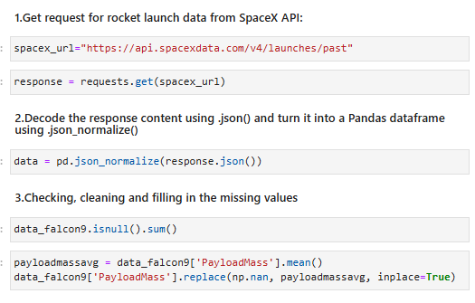
Data Collection – SpaceX API
Getting Response from API, collect data, clean the requested data and did some basic data wrangling and formatting.
GitHub URL to notebook
https://github.com/tanuakozyrek/IBM_Data_Science_Capstone_SpaceX.git/m1_1Lab_jupyter-labs-spacex-data-collection-api.ipynb

Slide 9
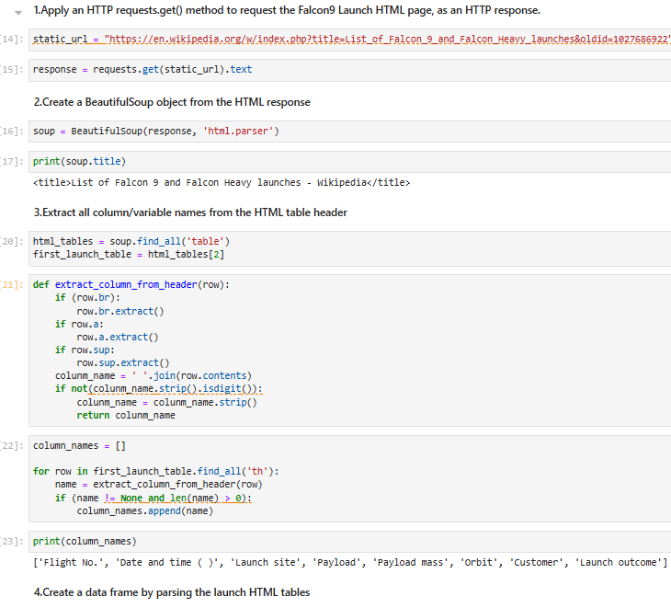
Data Collection - Scraping
Web scrapping to webscrap Falcon 9 historical launch records from a Wikipedia with BeautifulSoup
Was parsed the table and converted it into a pandas dataframe.
GitHub URL to notebook
https://github.com/tanuakozyrek/IBM_Data_Science_Capstone_SpaceX.git/m1_2Lab_jupyter-labs-webscraping.ipynb

Slide 10

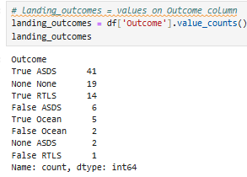
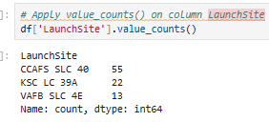
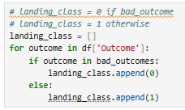
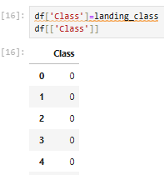
Data Wrangling
Was performed exploratory data analysis and determined the training labels.
Was calculated the number of launches at each site, and the number and occurrence of each orbits
Was created landing outcome label from Outcome column ()
GitHub URL to notebook
https://github.com/tanuakozyrek/IBM_Data_Science_Capstone_SpaceX.git/m1_3Lab_labs-jupyter-spacex-Data-wrangling.ipynb

Slide 11
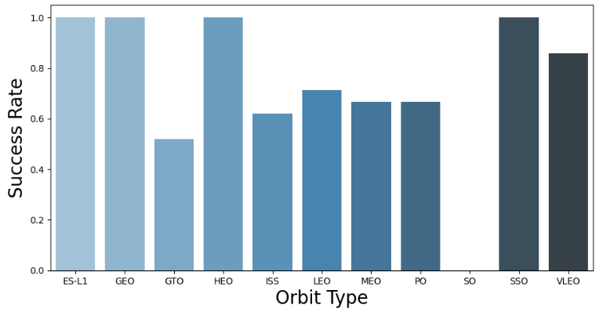
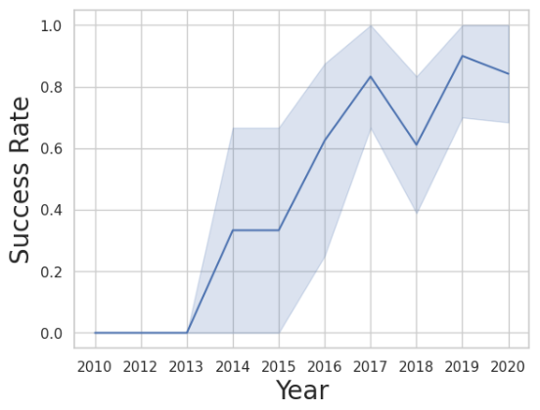
EDA with Data Visualization
We performed exploratory Data Analysis and Feature Engineering using Pandas and Matplotlib. Was explored the data by visualizing the relationship between flight number and launch site, payload and launch site, success rate of each orbit type, flight number and orbit type, the launch success yearly trend.
GitHub URL to notebook
https://github.com/tanuakozyrek/IBM_Data_Science_Capstone_SpaceX.git/m2_2Lab_edadataviz.ipynb

Slide 12
EDA with SQL
Was loaded the SpaceX dataset into a PostgreSQL database (from jupyter notebook).
There was using SQL queries to get the answers in the dataset:
The names of unique launch sites in the space mission.
The total payload mass carried by boosters launched by NASA (CRS)
The average payload mass carried by booster version F9 v1.1
The total number of successful and failure mission outcomes
The failure landing outcomes in drone ship, their booster version and launch site names.
GitHub URL to notebook
https://github.com/tanuakozyrek/IBM_Data_Science_Capstone_SpaceX.git/m2_1Lab_jupyter-labs-eda-sql-coursera_sqllite.ipynb

Slide 13
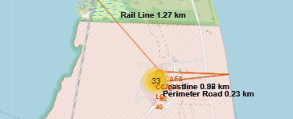
Build an Interactive Map with Folium
Was marked all launch sites, and added map objects such as markers, circles, lines to mark the success or failure of launches for each site on the folium map.
Was assigned the feature launch outcomes (failure or success) to class 0 for failure, and 1 for success.
Was identified which launch sites have relatively high success rate.
Was calculated the distances between a launch site to sites near railways, highways and coastlines.
•Are launch sites in close proximity to railways? No
•Are launch sites in close proximity to highways? No
•Are launch sites in close proximity to coastline? Yes
•Do launch sites keep certain distance away from cities? Yes
GitHub URL to notebook
https://github.com/tanuakozyrek/IBM_Data_Science_Capstone_SpaceX.git/m3_lab1_lab_jupyter_launch_site_location.ipynb

Slide 14
Build a Dashboard with Plotly Dash
Was built an interactive dashboard with Was plotted pie charts showing the total launches by a certain sites
We plotted scatter graph showing the relationship with Outcome and Payload Mass (Kg) for the different booster version.
GitHub URL to notebook
https://github.com/tanuakozyrek/IBM_Data_Science_Capstone_SpaceX.git/dash_app_SpaceX.py

Slide 15
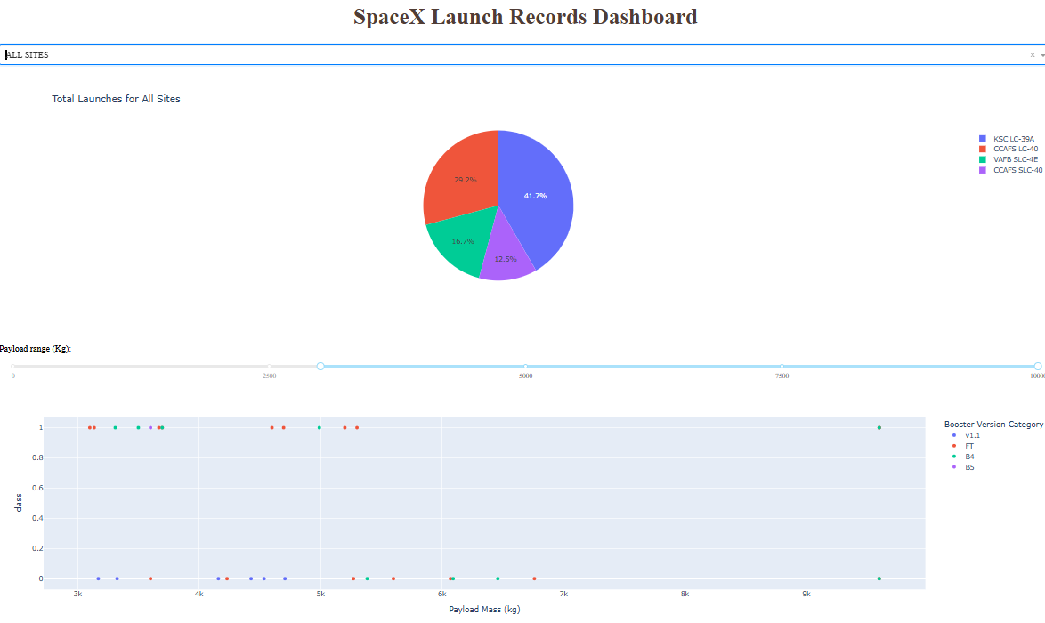
Build a Dashboard with Plotly Dash
•The dashboard can be used to analyze SpaceX launch data and answer the following questions:
Which site has the most success?
Which site has the highest launch success rate?
Which payload range(s) has the highest launch success rate?
Which payload range(s) has the lowest launch success rate?
Which version of F9 Booster (v1.0, v1.1, FT, B4, B5 etc.) has the highest level successful launch percentage?

Slide 16
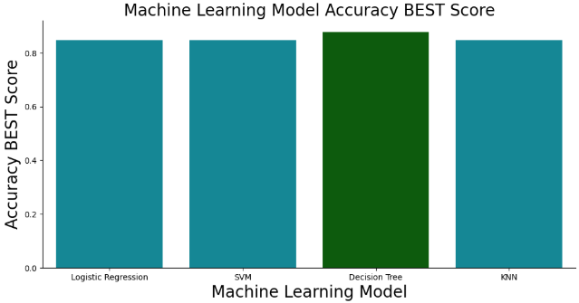
Predictive Analysis (Classification)
Building models:
load the data using numpy and pandas, standardize the data.
split data into training and test data.
built different machine learning models and tune different hyperparameters using GridSearchCV.
Evaluating models:
use accuracy as the metric for model, get tuned hyperparameters for each type of algorithms
plot Confusion Matrix
Finding the best classification model:
The model with the best accuracy score wins the best performing model
GitHub URL to notebook
https://github.com/tanuakozyrek/IBM_Data_Science_Capstone_SpaceX.git/m4_lab1_SpaceX_Machine Learning Prediction_Part_5.ipynb

Slide 17
Results
Exploratory data analysis results
Interactive analytics demo in screenshots
Predictive analysis results

Slide 18

Section 2

Slide 19
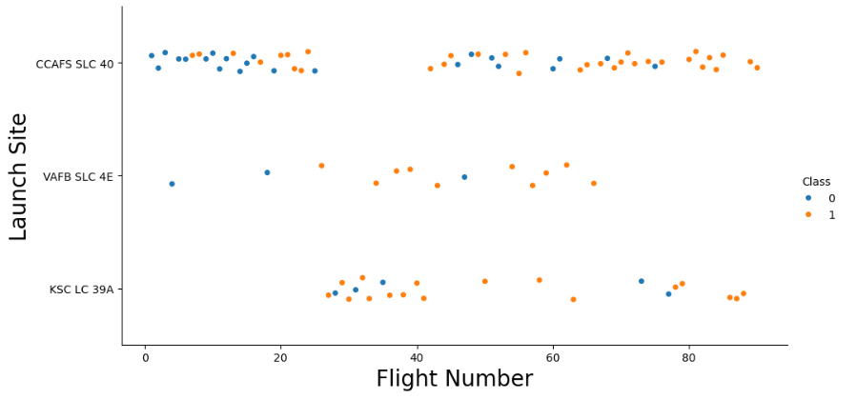
Flight Number vs. Launch Site
The more amount of flights at a launch site the greater the success rate at a launch site.

Slide 20
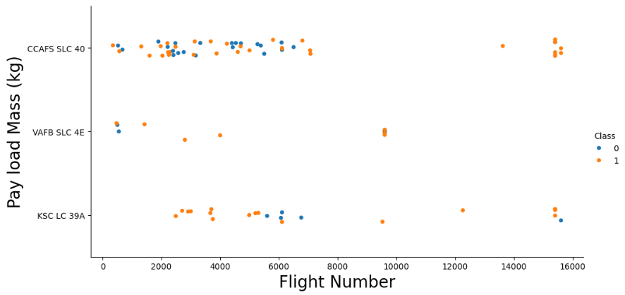
Payload vs. Launch Site
The greater the payload mass for Launch Site CCAFS SLC 40 the higher the success rate for the Rocket.

Slide 21
Success Rate vs. Orbit Type
Orbit GEO,HEO,SSO,ES-L1 has the best Success Rate.

Slide 22
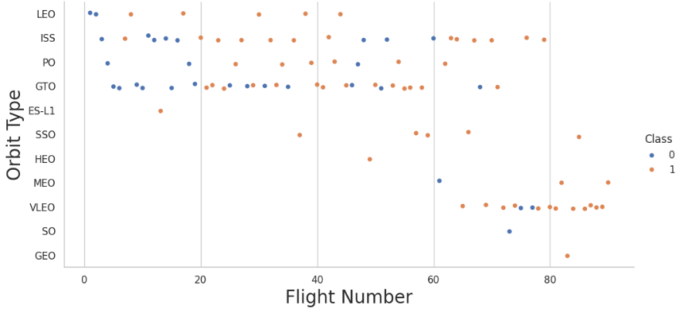
Flight Number vs. Orbit Type
LEO orbit's Success appears related to the number of flights; on the other hand, there seems to be no relationship between flight number when in GTO orbit

Slide 23
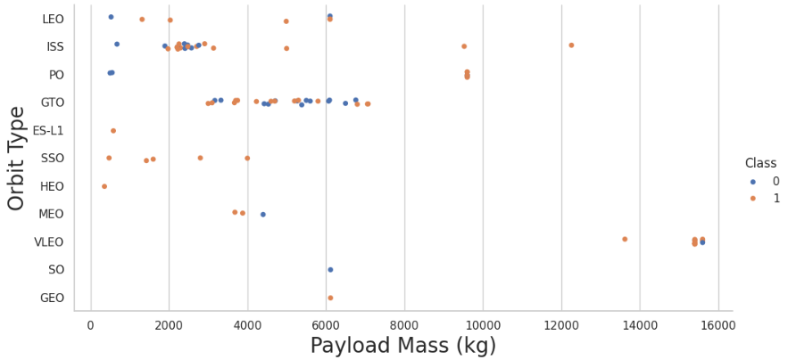
Payload vs. Orbit Type
Heavy payloads have a negative influence on GTO orbits and positive on GTO and Polar LEO (ISS) orbits.

Slide 24
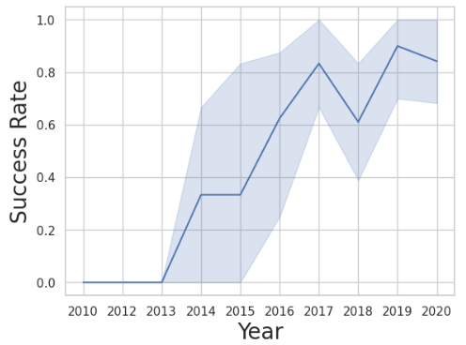
Launch Success Yearly Trend
Success Rate since 2013 kept on increasing till 2020.

Slide 25
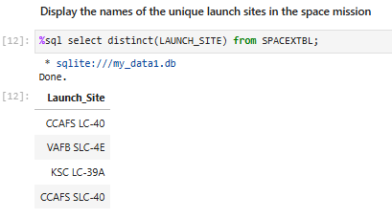
All Launch Site Names
Using DISTINCT in the query means that it will only show Unique values in the Launch_Site column from table.

Slide 26
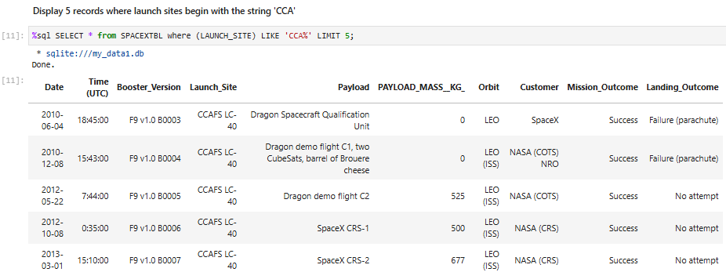
Launch Site Names Begin with 'CCA'
Using LIKE 'CCA%' suggests that the Launch_Site name must start with CCA

Slide 27
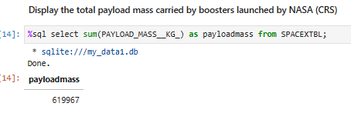
Total Payload Mass
The total payload carried by the NASA boosters was calculated using the sum() function.

Slide 28
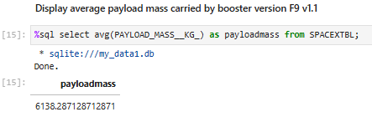
Average Payload Mass by F9 v1.1
The average payload mass carried by booster version F9 v1.1 was calculated using the avg() function.

Slide 29
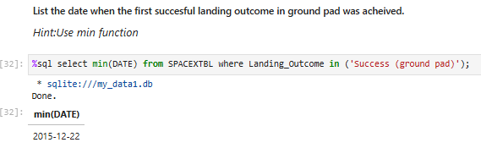
First Successful Ground Landing Date
The date of the first successful landing outcome on ground pad was found using the min() function.

Slide 30
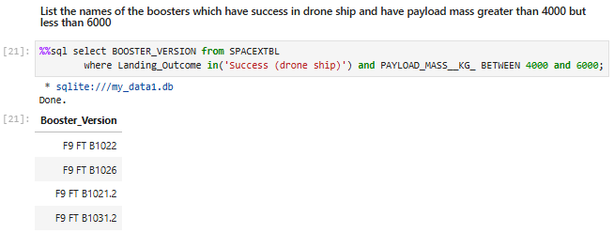
Successful Drone Ship Landing with Payload between 4000 and 6000
List the names of boosters which have successfully landed on drone ship and had payload mass greater than 4000 but less than 6000 was found using the WHERE clause.

Slide 31
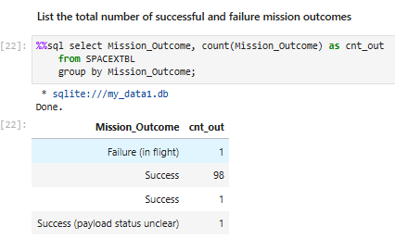
Total Number of Successful and Failure Mission Outcomes
The total number of successful and failure mission outcomes was found using the count() function and GROUP BY.

Slide 32
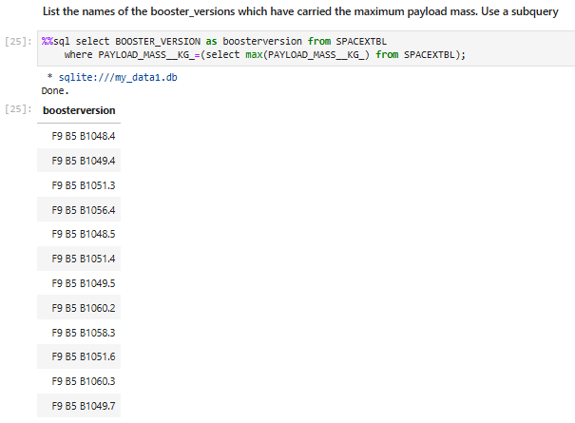
Boosters Carried Maximum Payload
List the names of boosters which have carried the maximum payload mass was found using the WHERE clause and subquery.

Slide 33
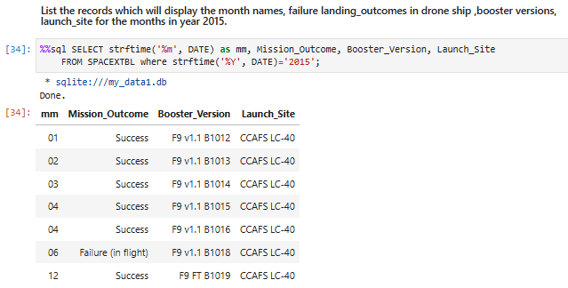
2015 Launch Records
List the failed landing_outcomes in drone ship, their booster versions, and launch site names for in year 2015 was found using the WHERE clause and strftime(‘%Y', DATE) function.

Slide 34
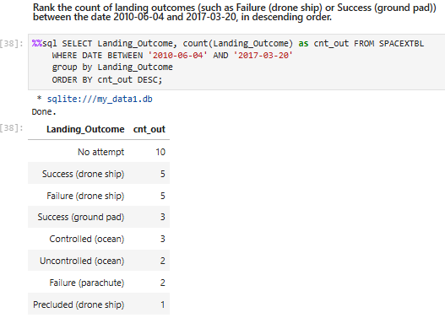
Rank Landing Outcomes Between 2010-06-04 and 2017-03-20
Rank the count of landing outcomes (such as Failure (drone ship) or Success (ground pad)) between the date 2010-06-04 and 2017-03-20 (in descending order) was found using a combinations of the count() function, the WHERE clause, GROUP BY and ORDER BY DESC.

Slide 35

Section 3

Slide 36

All launch sites global map markers

Slide 37
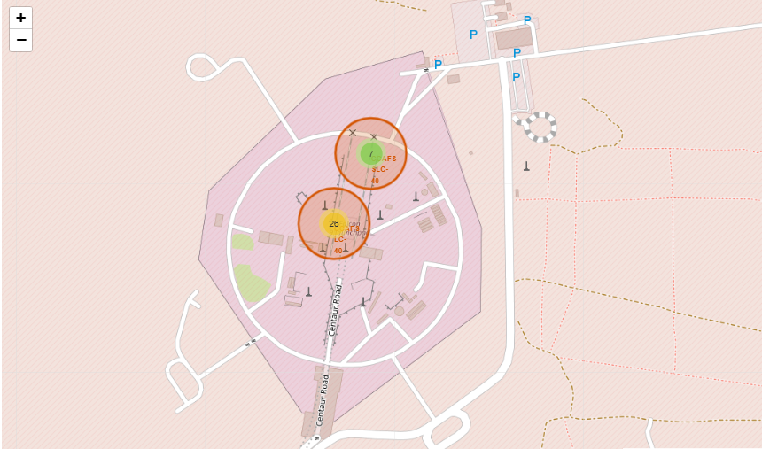
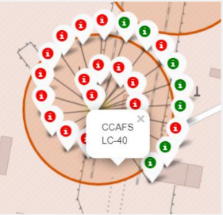
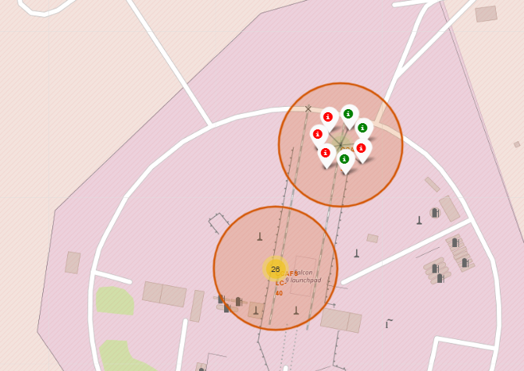
Markers showing launch sites with color labels
Green Markers show Successful Launches and Red Markers show Failures.

Slide 38
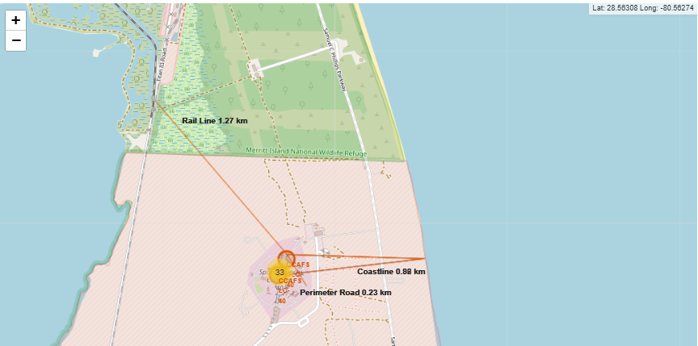
Launch Site distance to landmarks
The launch site with distance to nearest city, railway, highway (distance was calculated and lines were drawn using PolyLine)

Slide 39

Section 4

Slide 40
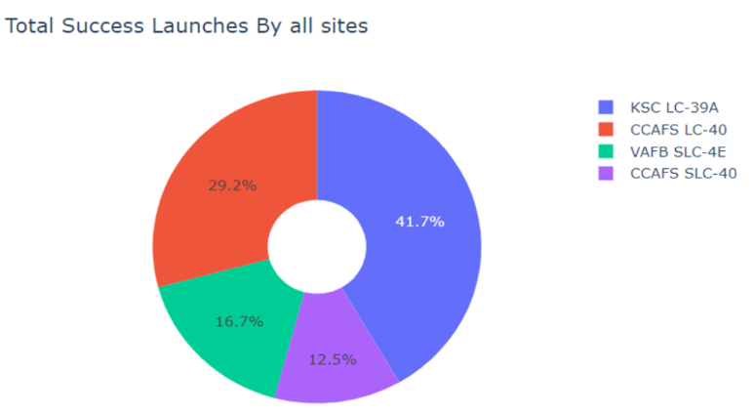
Success percentage achieved by each launch site
A piechart showing that KSC LC-39A has the most Success launches

Slide 41
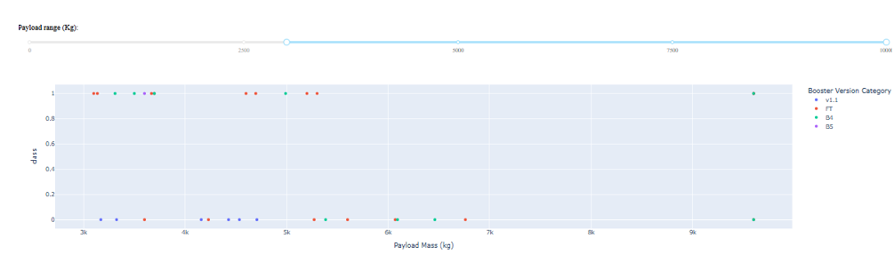
Payload vs Launch Outcome for all sites, with different payload selected in the range slider
Scatter plot shows Payload vs. Launch Outcome for all sites, with different payload selected in the range slider

Slide 42

Section 5

Slide 43
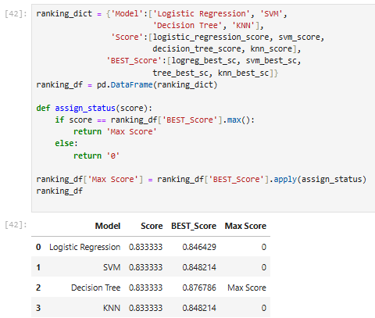
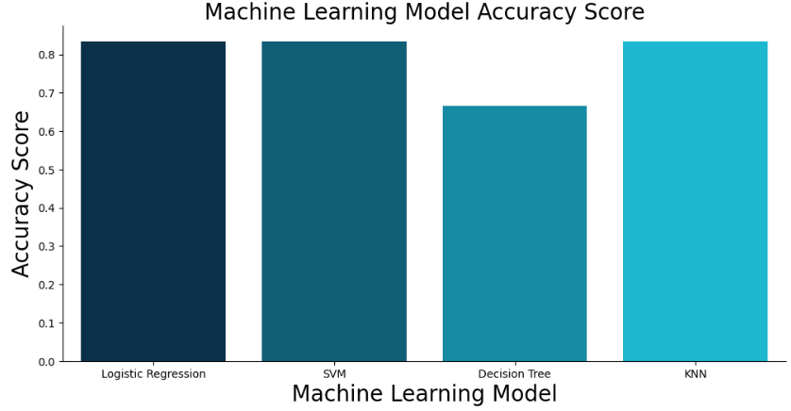
Classification Accuracy
The model with the highest classification accuracy is decision tree.

Slide 44
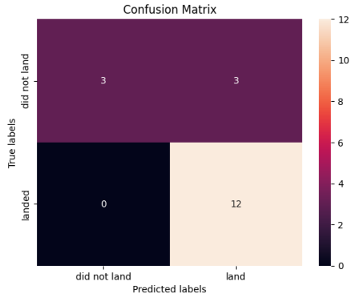
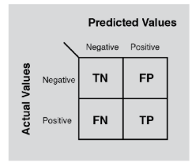
Confusion Matrix
The confusion matrix of the best performing model - decision tree.
The model decision tree can distinguish between the different classes. We see that the problem is false positives:
True Postive - 12 (True label is landed, Predicted label is also landed)
False Postive - 3 (True label is not landed, Predicted label is landed)

Slide 45
Conclusions
The payload is the most important factor in determining the success rate
The payload lets us know which booster version will have the highest success rate.
We can see that KSC LC-39A had the most successful launches from all the sites
Orbit GEO,HEO,SSO,ES-L1 has the best Success Rate
The Tree Classifier Algorithm is the best for Machine Learning for this dataset
There higher success rate brings down SpaceX’s overall cost per launch because they can reuse their first stage.

Slide 46


